Slide 1

Hello!
I am Arshak Rezvani
I am here because I love to give presentations.
You can find me at @ArshakRz

Slide 2

Comparison of Multi-Channel EEG Based Graph Learning Methods
Supervisor: Dr. Mohammad B. Shamsollahi
Tutor: Dr. Mohammad Memarian
#WomanLifeLiberty

Slide 3
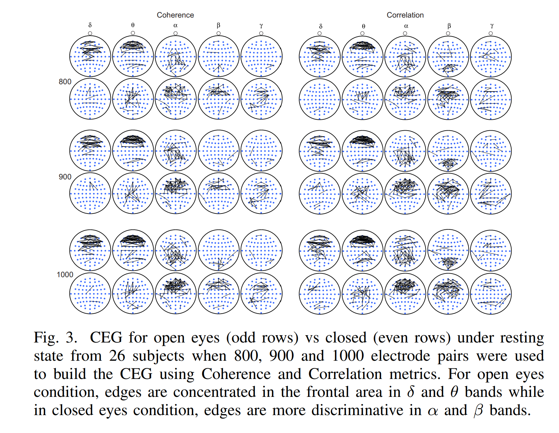
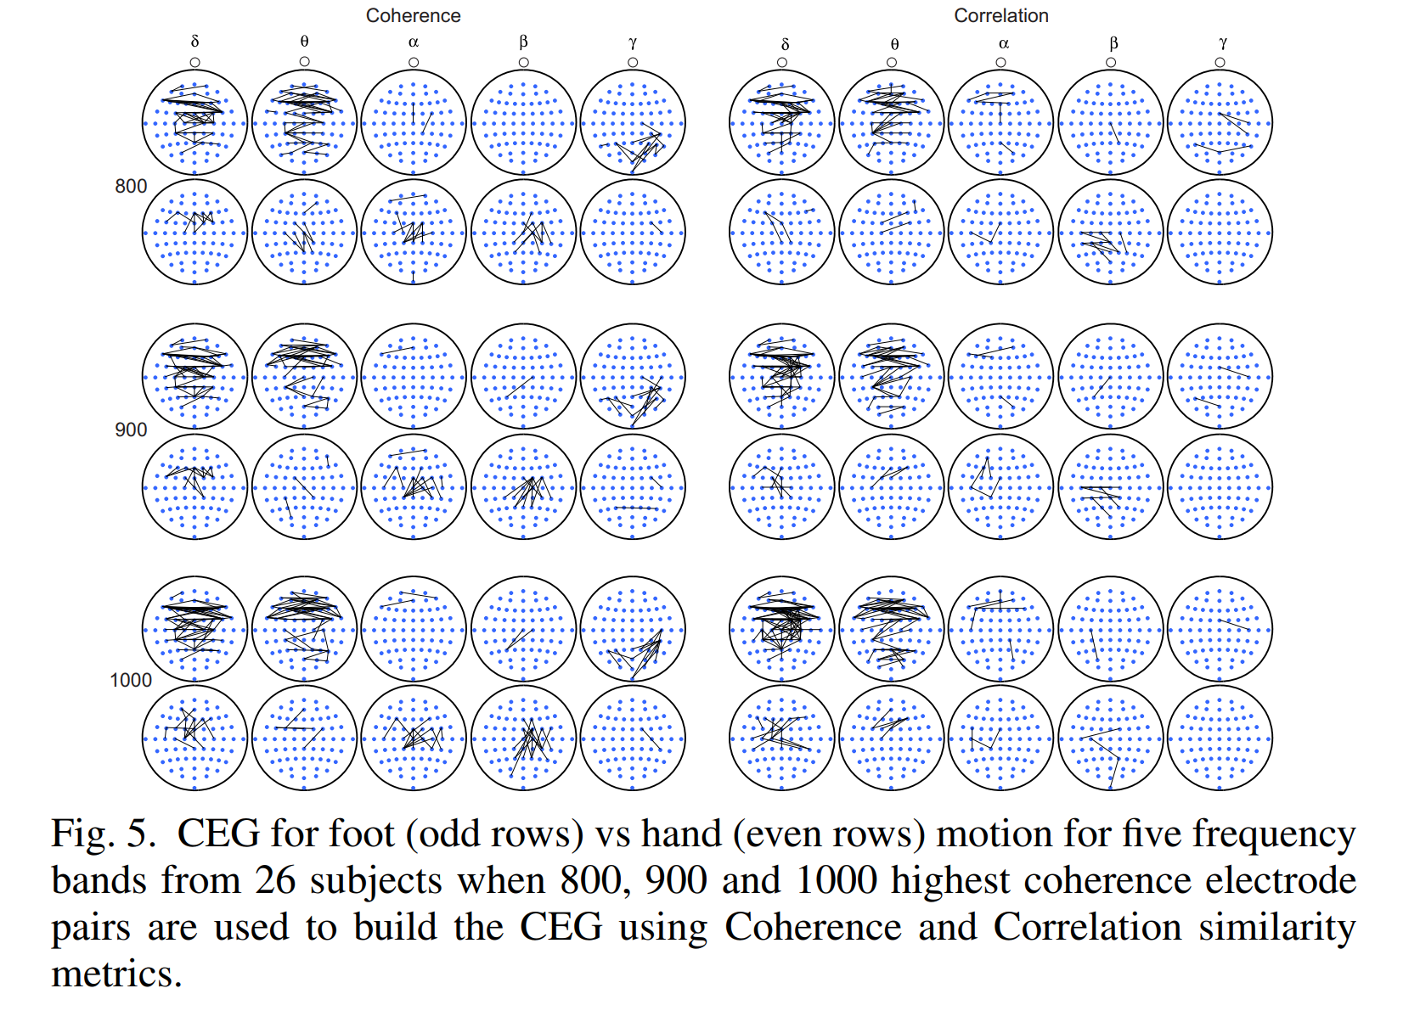

Slide 4
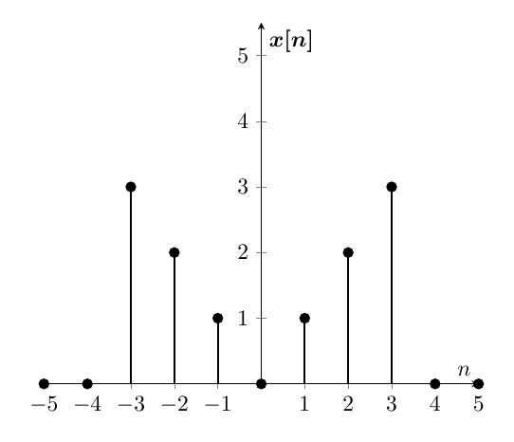
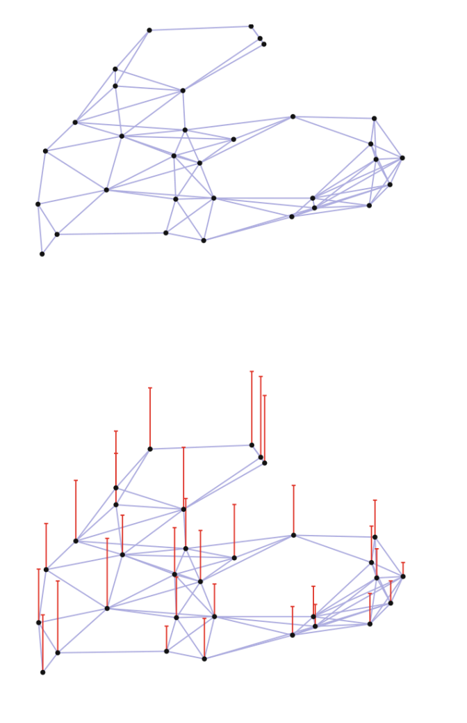
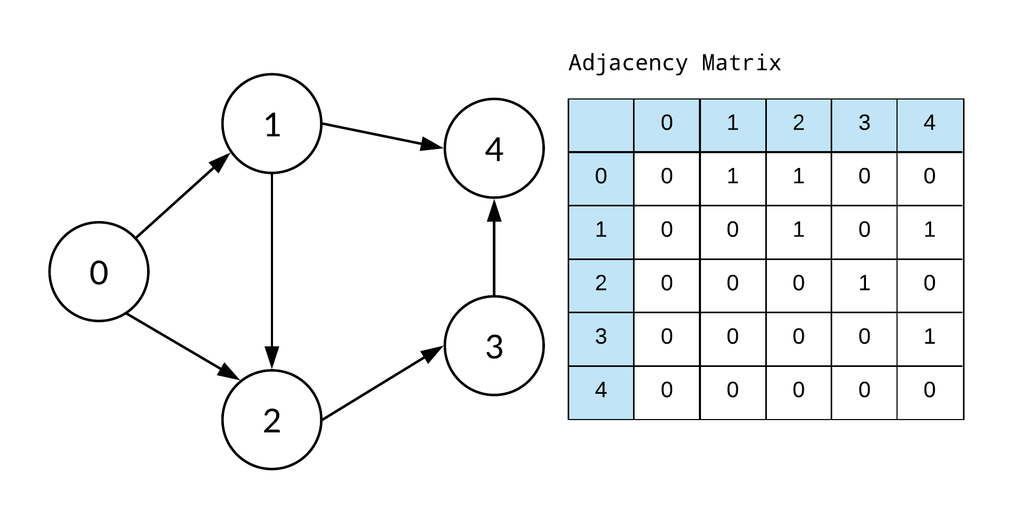
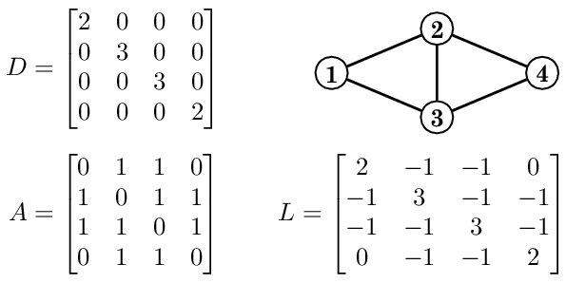
But What is a Graph Signal? [2]
A Graph!
Adjacency Matrix
Laplacian Matrix
Graph Signal
Definition and Example
It’s a Domain
Time
Frequency
Vertices
No Order!
A Vector

Slide 5
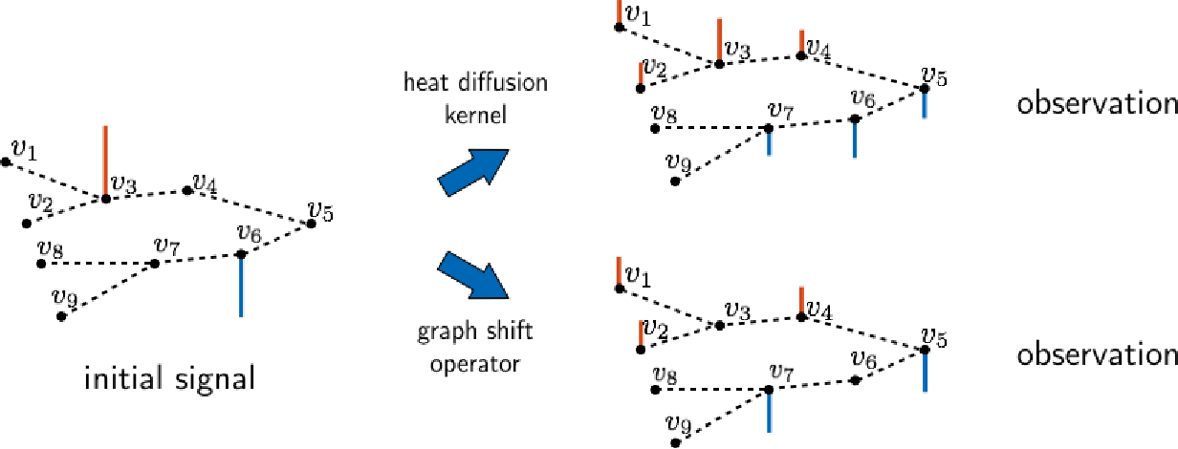
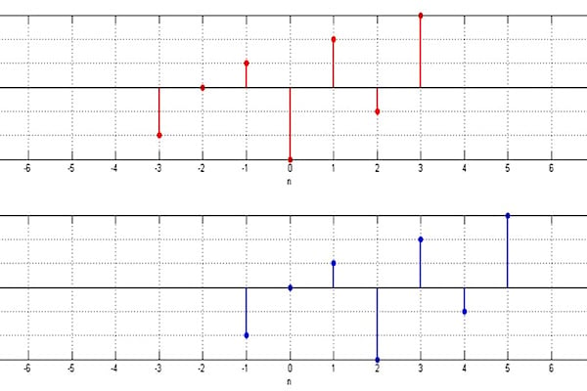
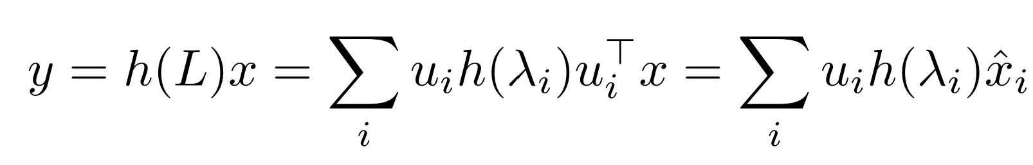
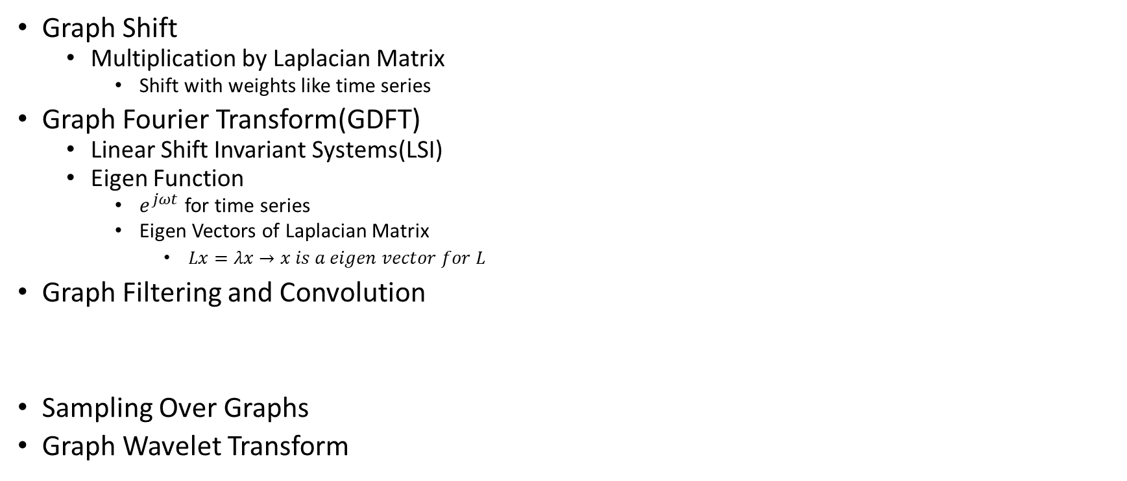
Graph Operations [2]
Graph Shift
Multiplication by Laplacian Matrix
Shift with weights like time series
Graph Fourier Transform(GDFT)
Linear Shift Invariant Systems(LSI)
Eigen Function
$e^{jωt}$ for time series
Eigen Vectors of Laplacian Matrix
$Lx=λx→x is a eigen vector for L$
Graph Filtering and Convolution
Sampling Over Graphs
Graph Wavelet Transform
Initial Signal
Shifted Signal

Slide 6
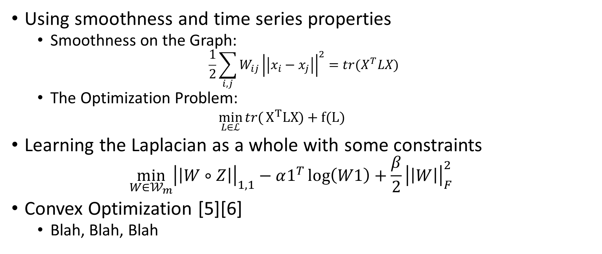
Learning Graphs From A Smooth Signal[3]
Using smoothness and time series properties
Smoothness on the Graph:
$$\frac{1}{2}\sum_{i,j}{W_{ij}}{\left|\left|x_{i}−x_{j}\right|\right|}^{2}=tr(X^{T}LX)$$
The Optimization Problem:
$\min_{L∈ℒ}{tr(}X^{T}LX)+f(L)$
Learning the Laplacian as a whole with some constraints
$$\min_{W∈𝒲_{m}}{{\left|\left|W∘Z\right|\right|}_{1,1}}−α1^{T}\log\left(W1\right)+\frac{β}{2}{\left|\left|W\right|\right|}_{F}^{2}$$
Convex Optimization [5][6]
Blah, Blah, Blah

Slide 7

Testing Criteria[8][9]
Accuracy of a Classifier Using Cross Validation
SVM
Neural Network
Decision Tree
Etc.

Slide 8
References
Hajipour Sardouie, Sepideh. " EEG Signal Processing Course Notes." Sharif University of Technology(2022). [1]
Amini, Arash A. " Graph Signal Processing Course Notes." Sharif University of Technology(2021). [2]
Wendling, Fabrice, et al. "From EEG signals to brain connectivity: a model-based evaluation of interdependence measures." Journal of neuroscience methods 183.1 (2009): 9-18. [3]
López, Rafae Lemuz, et al. "Graph theory for brain connectivity characterization from EEG." 2020 10th International Symposium on Signal, Image, Video and Communications (ISIVC). IEEE, 2021. [4]
Kalofolias, Vassilis. "How to learn a graph from smooth signals." Artificial Intelligence and Statistics. PMLR, 2016. [5]
Kalofolias, Vassilis, and Nathanaël Perraudin. "Large scale graph learning from smooth signals." arXiv preprint arXiv:1710.05654 (2017). [6]
Rubinov, Mikail, and Olaf Sporns. "Complex network measures of brain connectivity: uses and interpretations." Neuroimage 52.3 (2010): 1059-1069. [7]
Sen, Bhaskar, et al. "Classification of obsessive-compulsive disorder from resting-state fMRI." 2016 38th Annual International Conference of the IEEE Engineering in Medicine and Biology Society (EMBC). IEEE, 2016. [8]
Saboksayr, Seyed Saman, Gonzalo Mateos, and Mujdat Cetin. "EEG-based emotion classification using graph signal processing." ICASSP 2021-2021 IEEE International Conference on Acoustics, Speech and Signal Processing (ICASSP). IEEE, 2021. [9]
Mathur, Priyanka, and Vijay Kumar Chakka. "Graph Signal Processing Based Cross-Subject Mental Task Classification Using Multi-Channel EEG Signals." IEEE Sensors Journal 22.8 (2022): 7971-7978. [10]

Slide 9
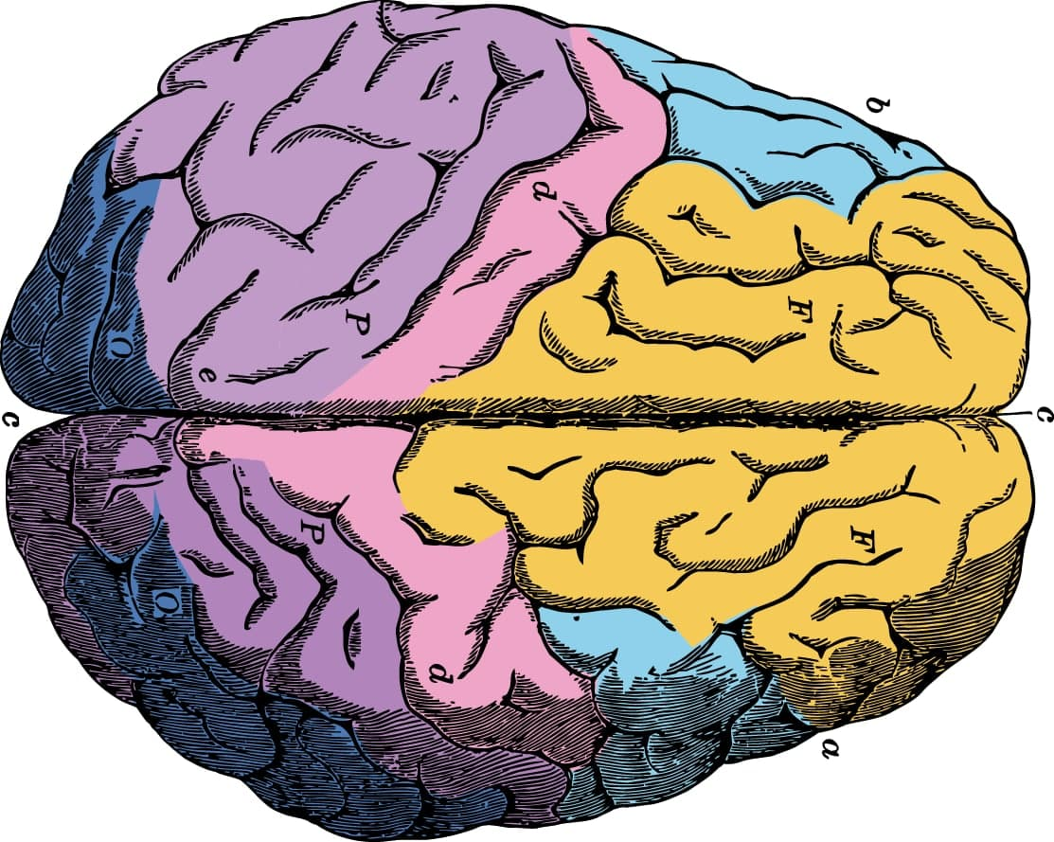
Thanks for Your Attention!

